Slide 1
NOAA SWPC Forecaster and Customer Requirements and Rationale
D.A. Biesecker
NOAA/SWPC

Slide 2
Questions We Will Address
What do (some) key users want from forecasters?
What do forecasters need from L1 and L5 to deliver key user needs?
What are the advantages to having goal requirements over threshold requirements for the specifics of space weather forecasting?

Slide 3
Power Grid Requirements
  Power grid operators can take a range of actions, some of which require days of lead time, others only 15-20 minutes. Some have said only 5 minutes.
  Forecasting the magnitude of the storm is more important than getting storm time correct
    However, an early prediction is better than a late prediction
  Forecast and specification of E field at their site
    6-hour forecast, updated hourly
  They are most interested in amplitude and duration
    How does a particular storm relate to what they’ve seen before?
    What is the occurrence frequency of large storms?

Slide 4
Geophysical Requirements
  Geophysical surveyors, mining and drilling operations
  Forecasts >1 day up to 3 day of geomagnetic disturbances
    Longest lead times needed for planning surveys
    Shorter lead times avoid poor quality surveys already planned
  Post-event knowledge <1 day
    e.g. to correct magnetically oriented drilling requires a time scale of ~1 day

Slide 5
GNSS Applications
Radar systems, GNSS location systems, Surveying
>1 hour forecasts of TEC
  Allows users to postpone or modify operations
Nowcasts of total electron content (within 5 minutes)
  Real-time data needed to correct GNSS positions

Slide 6
Aviation Requirements
  Detailed requirements documented in ICAO Meteorology Panel (METP) Second Meeting (METP/2) Montreal 17-21 October 2016
  Need prediction and monitoring of
    HF Radio communications impacts
    GNSS navigation
    Radiation exposure
  Forecasts of all of the above for the next 6, 12, 18, and 24 hours
    Moderate (tbd)
    Severe (tbd)
  Spatial Ranges and Resolutions
    Flight level 25,000-60,000ft w/3,000ft resolution
    Longitude resolution 15 degrees
    Latitude resolution 30 degrees

Slide 7
Satellite Launch Operations
Different customers require different energies and flux levels
>10 MeV proton flux prediction and specification
  Forecast up to 2 days ahead
  Specified up to 4 minutes before launch
> 50 MeV proton flux and heavy ion flux prediction and specification
  Forecast up to 2 days ahead
  Specified up to 4 minutes before launch

Slide 8
What do forecasters need from L1 & L5
L1 provides predictive capabilities on time scales of 1 hour to 4 days
  L1 supports solar wind monitoring
    CME imaging really only there because it’s an opportunity
    But SOHO showed why remote sensing and L1 really get along
    L1 is in addition to GOES and ground based instruments
  Therefore, L1 supports geomagnetic storm warnings
    Potentially longer than the typical 1 hour with suprathermal ions
      e.g. shock timing/intensity

Slide 9
SWPC Models Driven by L1 Data
Geomagnetic Storms
  Geomagnetic Activity
    Geospace Model (part of the UMich SWMF)
    Wing Kp
    Aurora Forecast
Ionospheric Activity
    Coupled Thermosphere Ionosphere Plasmapshere Electrodynamics Model (CTIPe)
    Whole Atmosphere Model/Ionosphere Plasmasphere Electrodynamics Model (WAM/IPE)
Satellite Environment
    Relativistic Electron Forecast Model (REFM)

Slide 10
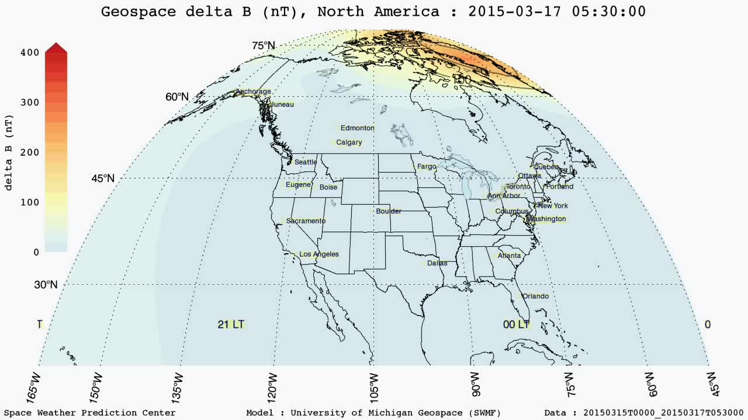
Saint Patrick’s Day Storm
March 17, 2015
Movie courtesy of George Millard (CU/CIRES)
Notes:
Here is a movie of the St .Patrick’s Day Storm. Movie highlights the need for a regional forecast: Different forecasts for Seattle vs. New England etc.
George developed custom color scale for this product to highlight activity.
Give much more detailed information than just one global value like Kp
Still early in development – much validation is still needed -> this gives us the capability of creating a region product with regional forecasts.
Ultimately want to make dynamic products with pull down menu from which you can request the data.

Slide 11
Value of L5 to Forecasters
Geomagnetic Storms
Geomagnetic storms (NOAA G scale)
  Better characterization of inputs to WSA-Enlil (CME’s and Background Solar Wind)
    Removes near/far side ambiguity of some CMEs
  Improved forecasts of co-rotating structures
  Sun-Earth tracking should further improve CME arrival time forecasting
    Need to move to ensembles and data assimilation
Required Instrumentation
  White light coronagraph
  Heliospheric Imager
  Magnetograph (vector?)
  Magnetometer
  Solar Wind Thermal Plasma

Slide 12
Value of L5 to Forecasters
Solar Radiation Storms
Solar Radiation storms (NOAA S scale)
  Proton events originating east of or close to central meridian as seen from Earth are well connected to L5
    Delayed onset at Earth
Required Instrumentation
  Relativistic (>10 MeV) proton monitor

Slide 13
Value of L5 to Forecasters
Radio Blackouts
Radio Blackouts (NOAA R scale)
  Improved forecasts of solar flares
    Current probabilities improved by removal of foreshortening of active regions near limb
    Future probabilities improved through observation of active region magnetic complexity and flare history
Required Instrumentation
  Magnetograph
  Solar X-Ray Sensor w/quad-diode (EXIS)

Slide 14
NOAA Requirements Process
NOAA carries two levels of requirements for any observation
  Threshold: minimally accepted
  Objective/Goal: ideal
NOAA requires validation of threshold requirements
  Green: OSEs & OSSEs, peer reviewed journals, operational procedures
  Yellow: Subject Matter Expert statements
  Red: Unable to validate
NOAA requires all but a handful of the threshold requirements for any program area (e.g. Space Weather) to be Green. A couple requirements may be Yellow.
NOAA does not require validation of objective/goal requirements
In practice, instrument builders must meet threshold requirements and then try to meet goal requirements where the cost or technical aspect of doing so does not become a mission driver

